Slide 1
Maryland Public Service Commission
The mission of the Maryland Public Service Commission is to ensure safe, reliable, and economic public utility and transportation services to the citizens of Maryland

Slide 2
Table of Contents
Slide | Section Title
3 | Transition to New SREC Application Portal
4 | Overview of the Updated SREC Application Process
5 | Required Documentation
6 | Common Application Errors to Avoid
7 | Next Steps After Certification
8 | Frequently Asked Questions
12 | Glossary
13 | Utility Contact Information
14 | Resources & User Guide Link

Slide 3
New SREC Application Portal
Effective April 1, 2025: The Maryland PSC has transitioned to a new SREC Application Portal.
New Portal Access: Applicants must now submit all SREC applications through the updated portal: www.pscrec.com
PV Solar User Guide: SREC Portal User Guide

Slide 4
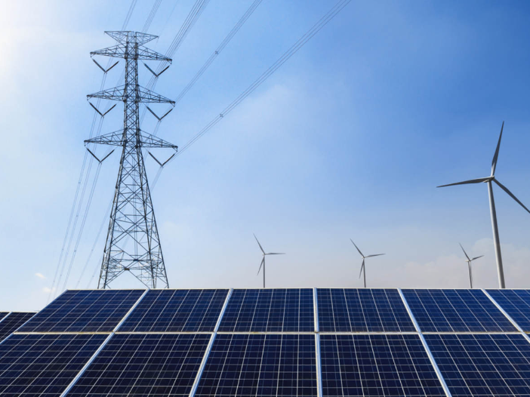
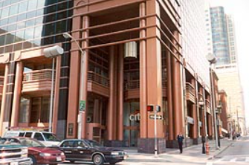
Application Process Overview
Step 1: Complete System Installation Ensure your solar photovoltaic (PV) system is fully installed and operational.
Step 2: Obtain Certificate of Completion Contact your utility provider to complete the Interconnection Agreement and receive the Certificate of Completion.
Step 3: Register on the New Portal Visit www.pscrec.com to create a new account or log in.
Step 4: Submit Application Follow the portal's step-by-step instructions to submit your SREC application.
Step 5: Certification and SREC Management
Once certified by the Maryland PSC, you must register your facility with PJM GATS within 30 days.
All SREC tracking and management is done through the GATS system to ensure compliance with Maryland’s Renewable Energy Portfolio Standard (COMAR 20.61.03.03).
👉 www.pjm-eis.com
Maryland Public Service Commission

Slide 5
Required Documentation
Initial Application: First-time certification of your solar PV system. Required Documentation:
* Certificate of Completion: Must be signed and dated by both the customer and the utility. This document must be fully completed and indicate the TOTAL system size in both DC and AC. Example Certificate of Completion template: (BGE_Certificate_of_Completion.pdf).
* Certificate of Good Standing (if the system owner is a company): This certificate must be current and not older than one year.
Proposed Change/Growth Application: For amendments to an existing Maryland Certificate Number. This applies if you've recently acquired a property, made date changes, or increased system capacity.
Required Documentation:
* Copy of Original Certificate - (i.e. original application) * Original Letter Order - Includes the initial Maryland Certificate number, found in the email received upon application approval (e.g., MD-xxxx-Sun-01). * Brief Explanation Letter - Describe the changes being made. * Certificate of Good Standing (if the system owner is a company) - This certificate must be current and not older than one year. * Updated Certificate of Completion - Must be signed and dated by both the customer and the utility.
** If the original Letter Order and original Certificate are unavailable, you may submit a screenshot of the system as it appears in the registered GATS account as an alternative.

Slide 6
Common Application Errors to Avoid
Incomplete Certificate of Completion: Ensure all fields are filled out and signatures are present.
Discrepancies Between Documents: All information must match across the application and supporting documents (i.e., Certificate of Completion).
Incorrect System Capacity Reporting: Report the system’s DC and AC capacity accurately as per the Certificate of Completion.
Expired Documents: Ensure all certificates and documents are current and valid.
If you have any questions related to the application process, please email pvsolarapplication.application@maryland.gov

Slide 7
Next Steps After Certification
GATS Registration:
To begin earning and managing your SRECs, please ensure the following:
Create a GATS Account: Visit the PJM-EIS website at www.pjm-eis.com and sign up for a GATS account.
Register your Facility in GATS: Once logged in, navigate to the “Assets” section and click “Register Solar Photovoltaic Generator.” Enter your MD PSC Certification Number during registration.
Submit Meter Readings: After successful registration, you can begin submitting monthly solar production readings to GATS. Your SRECs will be tracked and issued based on these readings.
Monitor SREC Status: Once your system is registered, GATS will issue SRECs corresponding to the system's generation. SRECs will be issued monthly following the submission of verified meter readings. Be sure to monitor your account regularly for updates.
Compliance: Ensure compliance with Maryland's Renewable Portfolio Standard (RPS) requirements.

Slide 8
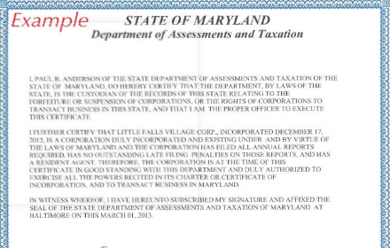
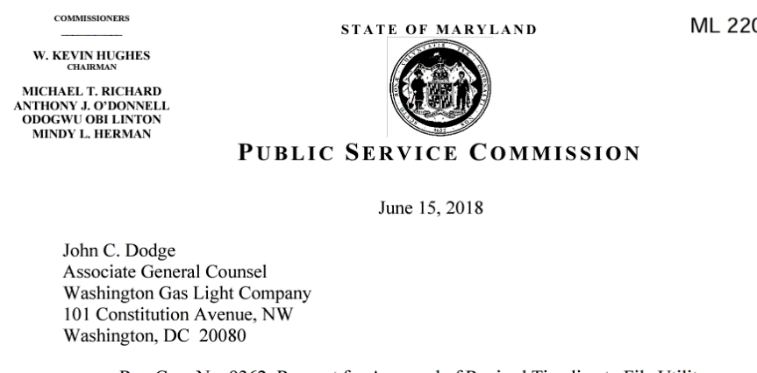
Frequently Asked Questions
How can I obtain a Certificate of Completion?
The Certificate of Completion is issued by your utility provider. You will need to complete the applicable interconnection forms and return to the utility for their review and signature.
What is a Certificate of Good Standing and how can I obtain one?
A certificate provided by the Maryland Department of Assessment and Taxation, which verifies that a business entity is in “good standing,” and all documents and fees required by law to be submitted to the Department have been received, and that no other government agency has notified the Department that the entity is delinquent in tax payments.
Maryland Department of Assessments and Taxation
What is a letter order?
This is the certificate received upon the initial approval of the solar PV system. (Please see example on the bottom right)

Slide 9
Frequently Asked Questions (cont’d)
What are Solar Renewable Energy Credits/ Certificates (SRECS)?
SRECs represent 1 megawatt-hour of solar energy produced. In Maryland, system owners registered with the PSC and PJM GATS can earn and sell SRECs as part of the state’s Renewable Portfolio Standard (RPS) program.
Where do I get solar renewable energy credits from?
SRECs are issued through the PJM Generation Attribute Tracking System (GATS), a regional registry that tracks solar energy generation. PJM is the grid operator and wholesale market administrator for Maryland. For more details, visit the PJM GATS website.
What is an aggregator?
An aggregator is a third party that manages and trades renewable energy credits, like SRECs, on behalf of system owners.
Could I obtain SRECs on my own?
Yes! To do so, first certify your solar PV system with the Maryland Public Service Commission (PSC). Once approved, you’ll receive a certification number. Then, register your system with PJM GATS by following their procedures for registration at https://www.pjm-eis.com/getting-started

Slide 10
Frequently Asked Questions (cont’d)
The Maryland Public Service Commission is not involved in SREC trading. Please reach out to the following agency for trading inquires:
PJM-EIS' Generation Attribute Tracking System (GATS) is a trading platform for solar renewable credits. Please contact them directly for Solar Renewable Energy Credits. Prior to registering with PJM GATS, you would first need a certification number from the Public Service Commission.
Website: https://www.pjm-eis.com/getting-started
Email: gatsadmin@pjm-eis.com
Telephone: (877) 750-GATS (4287)

Slide 11
Glossary:
Certificate Number: A unique identifier assigned to an APPROVED Application. Example: MD-XXXXX-SUN-01
Applicant Name: Party submitting the application.
System Owner Name: Party who owns the system.
Utility: Company that provides electricity to your facility.
Fac Name: Facility owner listed on the Interconnection Agreement Certificate of Completion (IACOC).
Fac Address: Facility address listed on the IACOC.
Filing Company Name: Aggregating company (if applicable)
Operation and Online Date: Date the system was turned on at the facility.
Aggregate Net Metering: Aggregate Net Metering is a special type of net metering limited to certain customers and is accomplished by combining meter readings from multiple utility service points by using the physical interconnection of service points or by summing the total usage from two or more meters (virtual aggregation). See PUA 7-306.3 and COMAR 20.50.10.07 and .08. An agriculture example would be combining the load on a farm’s barn, outbuildings, and residence. A solar array may be installed on a barn, which would generally have excellent sun exposure, although it would use little electric power. Joining the load of the residence (which may have less roof area or be in a shady location) and outbuildings to the load of the barn would make the installation more practical and cost-effective for the customer.
Co-Location: Refers to a separately-metered solar array being located on the same or an adjacent parcel of land as another separately metered solar array. Co-location typically relates to Community Solar projects as discussed within PUA 7-306.2 and COMAR 20.62.03.08.

Slide 12
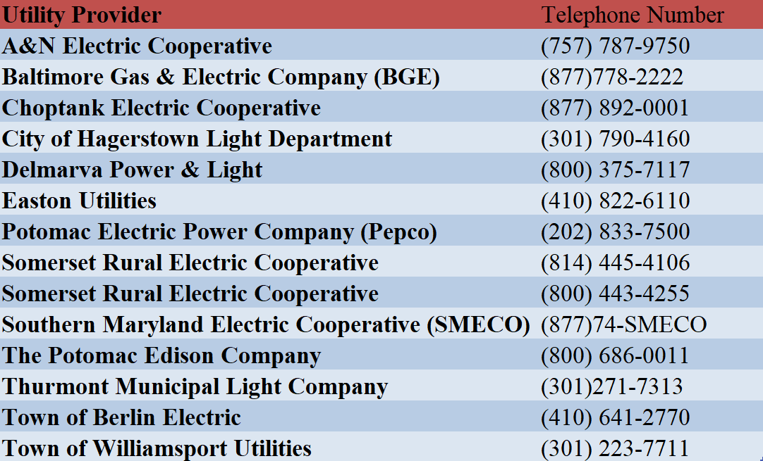
Utility Contact Information

Slide 13
Maryland SREC Contact Directory
The Maryland Public Service Commission (PSC) is responsible for the certification of solar photovoltaic (PV) systems under the state’s Renewable Energy Portfolio Standard (RPS) Program.
If you need assistance, please refer to the appropriate contact below:
SREC Portal and Training Questions 📧 monique.savoy1@maryland.gov 📧 amira.mitchell@maryland.gov
SREC Compliance Information 📧 christopher.lo@maryland.gov
SREC Application Fee Inquiries 📧 nancy.bittner@maryland.gov
Outstanding SREC Concerns 📧 matthew.phillips1@maryland.gov
For application-related concerns: Please use the PV Solar Portal messaging center to submit your questions or updates.

